Slide 1
Using social media at work
Isobel Hunter, Communications Lead, Central and South Genomics
Paula Mitchell, Deputy Director of Communications & Engagement
Birmingham Women’s and Children’s NHS Foundation Trust

Slide 2

Digital platforms at C&S Genomics
Our website underwent a complete redesign (completed 2025), and is aimed at both healthcare professionals seeking information on genomic conditions, research and testing, and patients seeking information, support and signposting
We utilise Mailchimp for our newsletter, which enables us to automate our output and analyse success
We use Ticket Tailor for our events

Slide 3
How we use socials at C&S Genomics
Targeted platforms:
LinkedIn: https://www.linkedin.com/company/nhs-central-and-south-genomics/
To advertise events and new roles, promote content, engage with awareness days and partner organisations, and share interesting research
The more employees engage with the platform, the better
YouTube: https://www.youtube.com/@CentralSouthGMSA
To upload resources such as previous webinars, how to complete forms, and guides on different conditions
Also used for case studies and engagement with specific awareness days where capacity allows, such as Genomics Conversation Week
We’re planning on expanding our content on this platform – volunteers welcome!

Slide 4
Using social media in a professional setting – NHS England guidance
Organisations and healthcare professionals must act responsibly when using social media platforms. This also holds true for professionals using social media accounts in a personal, non-professional capacity. Appropriate conduct by healthcare professionals and organisations on social media upholds the trust of the public in the professions.
Healthcare professionals and organisations must be mindful of the following:
the standards expected of healthcare professionals and organisations do not change on social media channels
clinicians should refrain from accepting friendship requests from current or former patients on their private or personal accounts
writing posts whilst identifying yourself as an organisation or health professional is likely to be received as trustworthy by the public and represent views of the profession
healthcare professionals posting in a professional capacity should use their identity and avoid posting or commenting on areas beyond their remit or competence
organisations and professionals are responsible for information or advice posted on social media in their professional capacity and should ensure it is evidence-based and correct at the time of posting
it is inappropriate to post informal, personal derogatory comments about patients and colleagues
social media should not be used to harass or victimise someone so before posting anything, consider whether the intended content can be deemed offensive

Slide 5
Using social media in a professional setting – HCPC guidance
Challenge discrimination
Maintain appropriate boundaries
Communicate appropriately
Respect confidentiality
Be honest and trustworthy

Slide 6
Challenge discrimination
Your services must be available to all service users and/or their carers. When you share content on social media you must do so in a way that does not hinder people’s access to your services. This means that you should be aware of the impact that your personal views, biases and beliefs may have on people’s access to your services.
This applies whether you are using a personal or professional social media account.

Slide 7
Maintain appropriate boundaries
It is just as important to maintain appropriate professional boundaries when using social media as it would be if you were communicating by any other method. You must always communicate with service users in a professional way. You might decide to set up a separate professional account where you provide general information for service users and the public. If you are employed and plan to use this account to have direct contact with service users, you should first agree with your employer whether this is appropriate.
Keep in mind that service users may still be able to find and contact you through your personal account. If this happens, we recommend that you refuse friend requests. If appropriate, say that you cannot mix social and professional relationships. If you want to follow up any contact you receive, consider using a professional communication channel, such as your professional email account.
If you include content relating to your professional role on a personal account or vice versa, think about the impact of the content that you will share on these different audiences when they see the material you post. Think carefully about what you share and who can see it.
Bear in mind the personal material you intend to share only with friends or family on a personal account could be accessible to a much wider audience, and once uploaded, it may not be possible to delete it or control how widely it is shared.

Slide 8
Communicate appropriately
When using social media, you should apply the same standards as you would when communicating in other ways. You must always be polite and respectful to others when communicating in a professional capacity.
When using social media, think about the accuracy and truth of the content that you share or circulate. Check that the information originates from people and/or organisations that are trustworthy. When engaging in online debate, ensure that your views are evidenced based, and that they are accurate to the best of your knowledge. Correct yourself if you have shared false, inaccurate, or misleading information.
You must also be careful that the information you share on social media does not reveal personal information about service users and/or their carers. Use your professional judgement in deciding whether to post or share something. Remember that comments or posts may be taken out of context or made visible to a wider audience than originally intended.

Slide 9
Respect confidentiality
When you post information about another person on social media, think about whether it is appropriate to share that information. If the information could allow a service user to be identified, you must not put it on a site without their permission. This information could include details about their personal life, health or circumstances, or images relating to their care. This applies whether you are sharing information to your personal connections or to the public.

Slide 10
Be honest and trustworthy
This means you need to think carefully about what you share online. Throughout your use of social media make sure that what you share does not bring your professional practice or your profession into disrepute. When using either a professional or personal account, your conduct should continue to respect service users, their carers and/or your colleagues and maintain fair access to services for all.
If you use social media to advertise or share information related to your professional practice, you must make sure it is accurate and true, by making reasonable checks to verify it. You may choose to include a disclaimer on your profile that your views are your own, and that they do not represent the views of your employer or anyone who contracts your services.

Slide 11
When it goes wrong
In 2018, it was reported that since 2013 more than 1200 NHS staff have been disciplined for using social media or messaging apps, an investigation has found. Of those who were disciplined at least 65 NHS staff members had lost their jobs, said the Times newspaper, which collected data from 194 NHS trusts in England through freedom of information requests.
One example of this is Rhoda Tagle, a trauma and orthopaedics nurse, who was struck off in 2024 following Facebook posts and subsequent comments which "were grossly offensive, prejudicial and discriminatory in nature.“
Another is Roberta Batchelor, ward manager, who was struck off after posting a highlighted section of the book of Deuteronomy stating “Foreigners who live in your land will gain more and more power, while you gradually lose yours. They will have money to lend you, but you will have none to lend them. In the end they will be your rulers.“
Trusts have also been reprimanded for sharing patient data on unauthorised platforms, such as WhatsApp: “Some 26 staff at NHS Lanarkshire accessed the WhatsApp group between April 2020 and April 2022, entering sensitive patient data including names, phone numbers, addresses, images, videos, screenshots and clinical information, according to the Information Commissioner’s Office. The WhatsApp group was initially set up to help staff communicate during the early days of the pandemic. However, it was not approved for processing patient data, which is classed by the GDPR as a “special category” of personal data. Article 9 of the law provides special protection for this category of data. The staff apparently began using the group for the sharing of this data without the trust’s knowledge. One non-staff member was accidentally added to the group, resulting in inappropriate disclosure of personal information to them, the ICO claimed, highlighting the dangers of shadow IT.”

Slide 12
Social media used well
The positive benefits of social media are Community, Connection and Communication
Provides the opportunity to build virtual audiences of like-minded and interested individuals/groups – removing physical and geographical boundaries
Connects individuals and groups – information sharing, support networks, awareness and learning, discussion and debate
Provides channels to share and access information

Slide 13
Social media used well
At BWC we have active social media accounts on Facebook(separate for Women’s & Children’s), Instagram (separate for Women’s & Children’s), LinkedIn (Trust) and X (reduced activity level).​
Our collective audience of followers is over 138,000
We deliver an ongoing programme of content (messaging and format) tailored to work for each individual platform and audience.
We average over 3m impressions (the total number of times content was displayed) and nearly 60,000 impressions (likes, reactions, comments, shares, saves and clicks on a social media) post per month

Slide 14
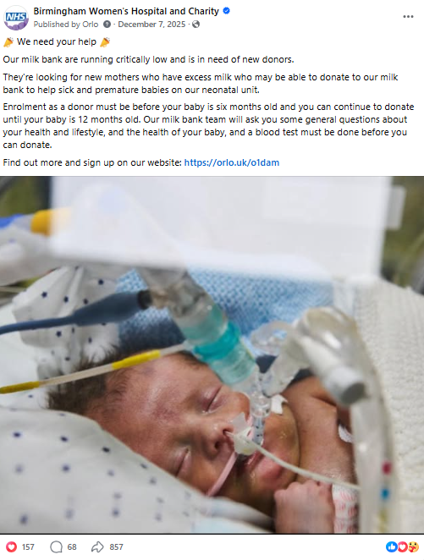
The Milk Bank at the Women’s Hospital provides donor breast milk to our own neonatal babies, as well as to hospitals around the region and beyond – it is the only one in the West Midlands.
In December 2025, we supported them in encouraging to address a current shortage.
A series of social media posts appealed for help from new donors. We reached over 140,000 people and content was shared over 900 times.
50 people contacted the milk bank in order to become new donors.

Slide 15
The Trust plays an important role in supporting Public Health messaging. A key time is during the Winter when it is important to help increase awareness and understanding of conditions, especially winter viruses, and encouraging the public to get vaccinated.
Research within our communities showed:
A lack of understanding of the difference between the flu and a cold
Low take up of flu vaccine with common reasons of "I think the flu is of minimal risk to me or my children“ and "Religious reasons"
We created short-form, informative and friendly videos around these topics and shared them on our channels and in community groups.
Our 2025 video campaigns reached more than 588k people and received1.2k shares - this was a record high for BWC’s social media channels.

Slide 16
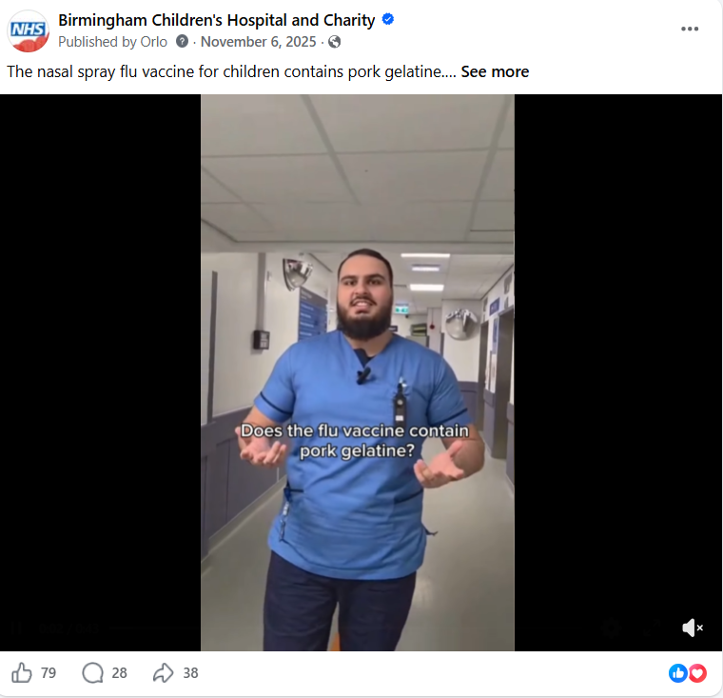
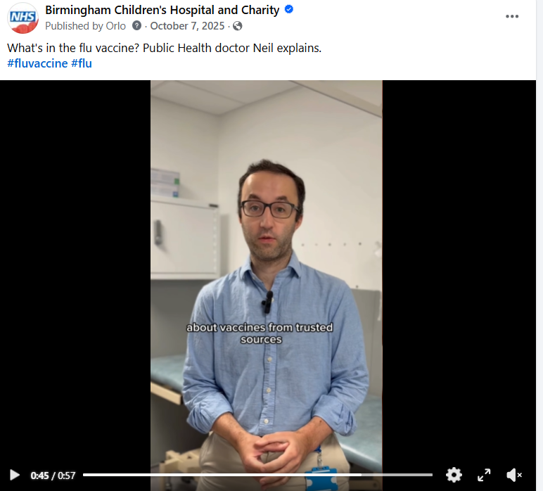

Slide 17
Local guidance
Aligned to the advice offered by the General Medical Council (GMC), Nursing and Midwifery Council (NMC), Health and Care Professions Councils (HCPC) and NHS England and NHS Employers.
All official Trust communication on social media is managed by the BWC Communications and Engagement team through its core channels.
Any ward or departmental accounts must be requested as affiliate accounts and be approved by the Communications team.
When we publish via social media platforms, we are putting information into the public domain and, in effect, are making a public statement. As such, comments, posts and videos that come ‘from the Trust’ should be treated in the same way as any public media and made via an official spokesperson through our Communications team.

Slide 18
Local guidance
Applies to use of personal accounts when an individual identifies themselves or can be identified, as a health professional or employee of BWC.
Any member of staff that make potentially discriminatory comments, posts, replies or any other content where their employer (BWC) is identifiable in their profile or from previous posts, will be subject to action under the Trust’s Conduct Policy.

Slide 19
Local guidance
Employees are expected to:
Be personally responsible for any content posted to social media channels or online participation, either personally, professionally or on behalf of the Trust.
Adhere to their professional code of conduct (if applicable).
Be personally responsible for ensuring the confidentiality of patients and families at all times when posting.
Be aware of all Trust policies, particularly those relating to bullying, discrimination and harassment and security of data to ensure these are not breached.
Declare any potential conflicts of interest as required by the Trust.
Report any incidents that breach this guidance relating to the use of social media channels or online participation using the Trust’s incident reporting system.

Slide 20
Local guidance
If an employee is using social media in a professional capacity, they should be aware that they will be perceived as being a representative of the Trust. Any material written by authors who represent themselves as employees of BWC is likely to be taken on trust and/or to represent the views of professionals more widely.
Before engaging in social media as a representative of the Trust, employees must become authorised to post/comment (either by the Executive Director of Communications and Partnerships for official Trust channels or by their line manager in the case of professional forums).

Slide 21
Local guidance
To act in a professional capacity authorised representative must:
Disclose they are an employee/contractor of the Trust, and use only their own identity, unless authorised to use an approved official account.
Disclose and comment only on information classified as public domain information.
Ensure all content published is accurate and not misleading and complies with all relevant policies.
Respect patient, employee and Trust confidentiality at all times. Ensure they are not the first to ‘make an announcement’ (unless specifically given permission to do so with approval from the Communications and Engagement team). If they do wish to make such an announcement permission should be sought from the Communications and Engagement team. Comment only on their area of expertise and authority. Ensure comments are respectful of the community in which they are interacting online.

